Slide 2

Team Great Gray Owl
AI Hackathon - Classical AI challenge, 2024
Adam Purkiss
Senior Principal Software Developer
A&G
November 07, 2024

Slide 3
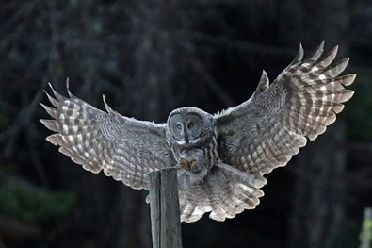
Team members
Team Great Gray Owl:
Adam Purkiss
Armel N’go
Derek Lo
Jannat Kaur
Vrinda Garg

Slide 4
User Story
American Bird Conservancy (ABC) is dedicated to conserving wild birds and their habitats throughout the Americas. American Bird Conservancy (ABC) is dedicated to conserving wild birds and their habitats throughout the Americas. With the help of AI we will help ensure that ABC can get the most out of the money they have access to. Through modelling of habitat, projects, activities and funding we can guide ABC on where to prioritize efforts.
Simply put we want ABC to get the most bang for their buck.
Challenge Overview
The American Bird Conservancy (ABC) is committed to conserving bird species and their habitats across the Americas. However, with limited funding and resources, ABC faces the challenge of prioritizing projects to achieve the highest impact. This project leverages data-driven AI models to assess ecological risks, conservation costs, and habitat potential, guiding ABC in strategic decision-making. Our goal is to help ABC maximize the effectiveness of their funding by identifying high-priority projects and providing actionable insights for sustainable conservation efforts.

Slide 5
Data Exploration

Slide 6
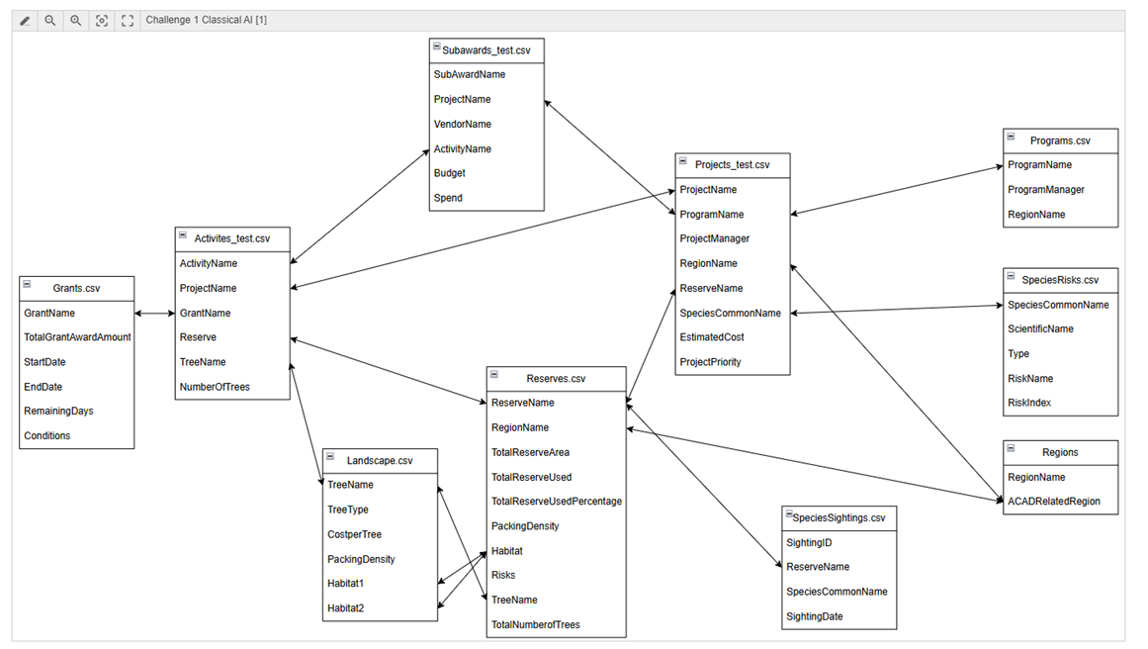
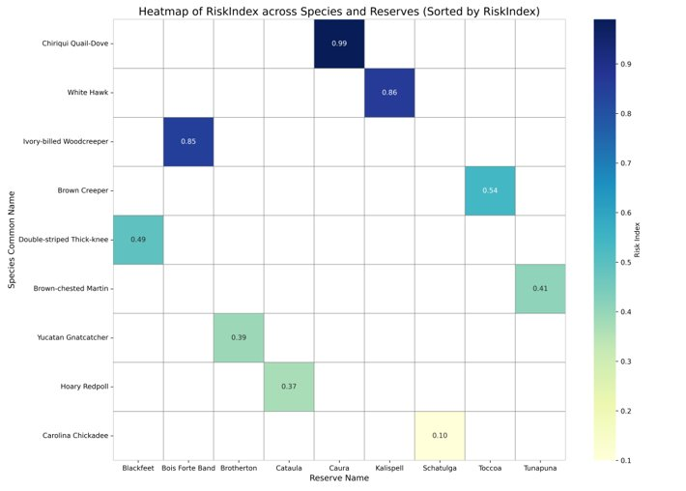
Visualization and Exploration of Data
We started off working on a visual representation of the data, trying to work out how the data worked together.
Species that appear in both the Projects and SpeciesRisks datasets represent those at risk and specifically targeted by at least one conservation project.

Slide 7
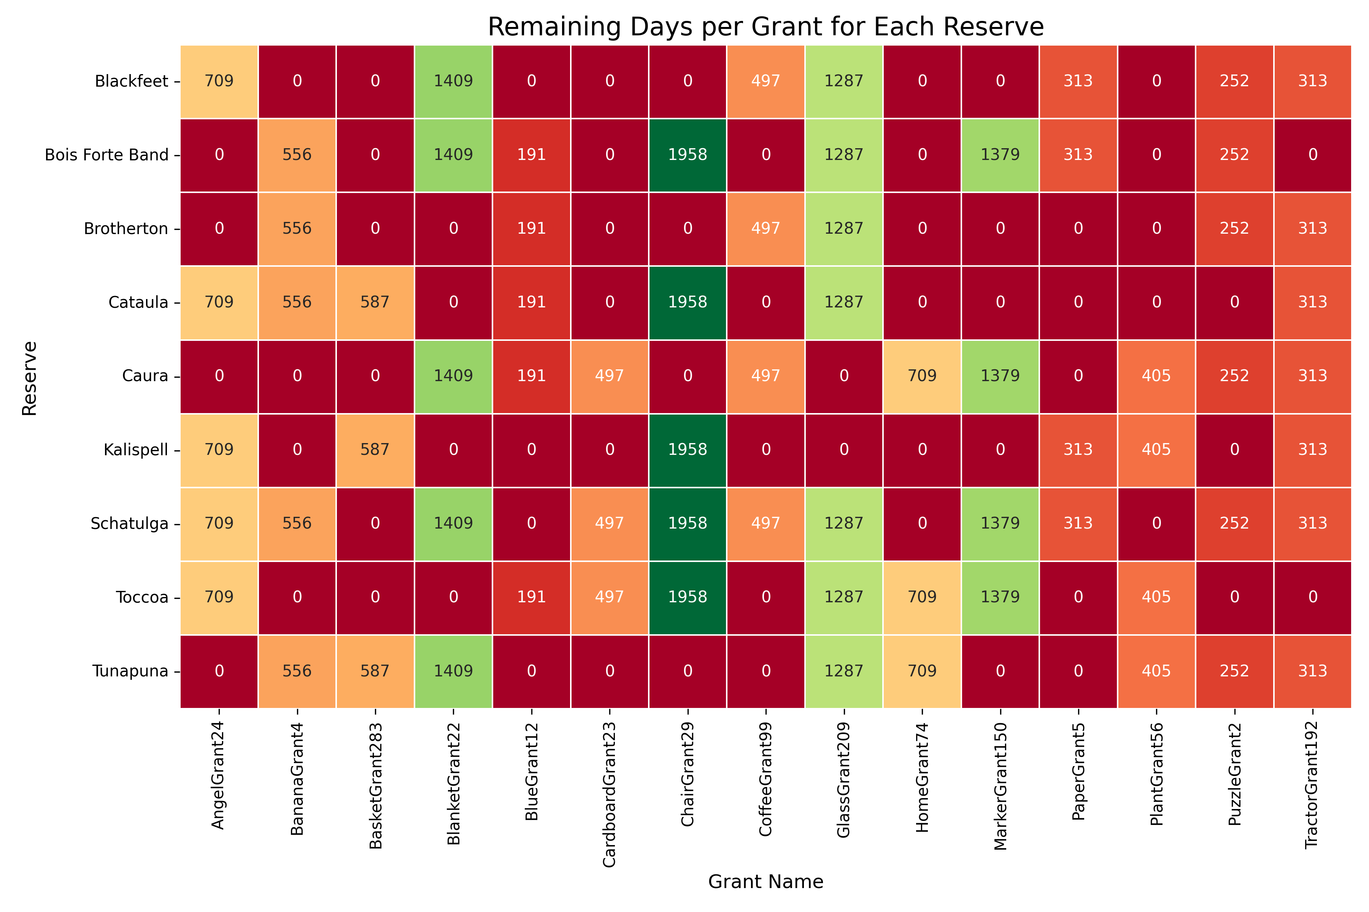
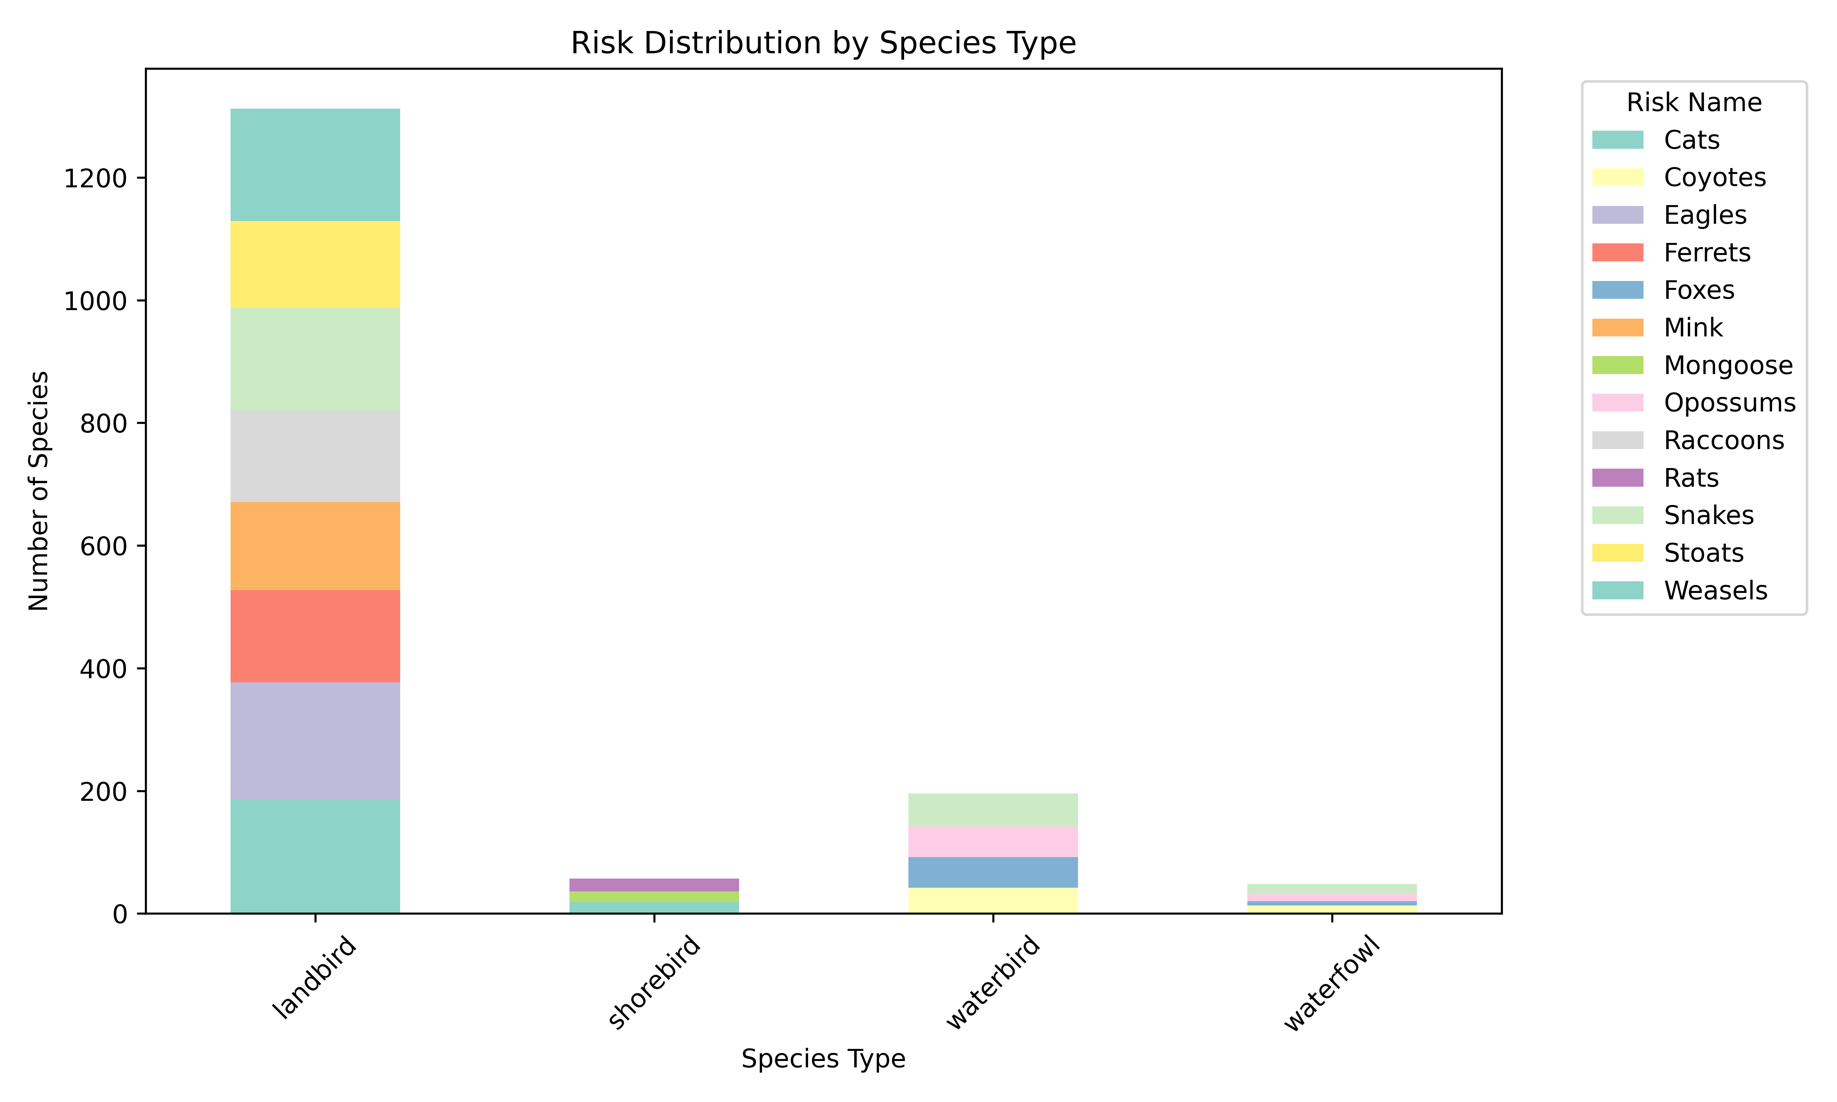
Exploratory Data Analysis
The following visuals show the remaining days for each grant by reserve and risk distribution for each type of species

Slide 8
Approach

Slide 9
Approach
Our approach aimed to build a model capable of predicting project priority for conservation efforts, using multiple features that capture ecological risk, activity impact, and funding aspects. We explored 16 datasets, encompassing project activities, regional bird risk indices, conservation areas, and budgets. Key features derived from these datasets included
Total Activities: The count of activities related to each project, serving as an indicator of the project’s scope.
Risk Index: A calculated risk metric to assess the urgency for intervention based on species vulnerability.
Potential Area to Plant Trees: Derived from reserve data, this feature estimates viable land area for planting, accounting for reserve density and existing coverage.
Adjusted Activity Cost: A measure of conservation costs per project, adjusted by subtracting the difference between budget and spend.
After initial exploration, we refined these features to enhance model accuracy, focusing on impactful predictors while minimizing noise. The in-depth explanation that follows describes how we prepared and selected features to optimize the model's performance.

Slide 10
Data Split

Slide 11
Data split
The initial data provided us with some test and training sets for projects, activities, and subawards.
We split the remaining data into training and validation sets using an 80/20 ratio, allowing us to train the model on most of the data while keeping a portion aside for fine-tuning and checking accuracy. The test data allowed for us to evaluate the model's performance on new data.
To make sure the model works well across different samples, we also applied cross-validation, helping us verify that our model makes reliable predictions.

Slide 12
Data Preprocessing

Slide 13
Data Preprocessing
Data Cleaning
Standardize Column Names: Stripped leading and trailing whitespace from all column names to ensure consistency and ease of reference across datasets.
Correct Data Types: Converted data types for key columns (e.g., EstimatedCost) to numeric or categorical types as needed. Additionally, converted data types in columns required for joins (like ProjectName and SpeciesCommonName) to ensure compatibility during merges.
Handle Inconsistent Formats: Standardized key columns (like ProjectName, ActivityName, and TreeName) to lowercase and removed extra whitespace for smooth merging across datasets.
Handling Missing Values
Drop Rows with Missing Target Values: Removed three rows with missing values in the ProjectPriority column, as these were critical for model training, and imputation would have introduced uncertainty in the target variable.
Fill or Drop Missing Values: For other columns, we filled missing values where feasible:
For BudgetMinusSpend, filled missing values with 0 if no subaward data was available, assuming no financial adjustment for those activities.
For other critical columns, dropped rows if filling was not appropriate and the missing data couldn’t be reasonably inferred.

Slide 14
Data Preprocessing
Feature Scaling
Standard Scaling Standardized numerical features where scaling was necessary to bring features to a similar range, especially for models sensitive to feature magnitudes i.e., SVM.
Conditional Scaling: In our initial tests, scaling reduced the performance of XGBoost, so we proceeded without scaling, allowing the model to work with raw feature values for better accuracy.
Feature Engineering
Created new features, including TotalActivities (count of activities per project), Risk Index (species vulnerability score), PotentialAreaToPlantTree (unused reserve area adjusted by packing density), and AdjustedActivityCost (total cost per activity adjusted by financial surplus or deficit).
Handling Corrupt Data in Subawards
Alternative Join Key: Identified inconsistencies in the ProjectName field within the subawards data, so we used ActivityName as the primary join key for merging with activities_train.
Linking with Projects: After merging subawards and activities via ActivityName, we linked this combined data with projects_train using ProjectName to ensure correct alignment across datasets.

Slide 15
Feature Engineering

Slide 16
Feature Engineering
1. Adjusted Activity Cost:
Mapping Activities and Landscape for Initial Cost Calculation
We started by mapping each activity to its corresponding data in the landscape dataset. Specifically, we looked up the cost per tree for each type of activity from the landscape data.
Then, we calculated the total cost of each activity by multiplying the number of trees with the cost per tree from the landscape data.
Integrating Subaward Data
To account for any financial adjustments from subawards, we joined this initial activity cost data with the subaward dataset using the unique identifier, ActivityName.
In the subaward data, we calculated the effective subaward by subtracting Spend from Budget (Budget - Spend). This subaward value indicates whether there was a financial surplus (positive value) or deficit (negative value) for the activity.

Slide 17
Feature Engineering
1. Adjusted Activity Cost:
Calculating Adjusted Activity Cost
For each activity, we adjusted the initial cost by factoring in the subaward
If the subaward (Budget - Spend) was positive (indicating a surplus), we subtracted it from the initial activity cost. This resulted in a reduced cost, as part of the activity was covered by the surplus.
If the subaward was negative (indicating a deficit), we added it to the initial activity cost. This captured the additional expenditure needed to cover the activity beyond the budget.
The resulting figure is what we call the Adjusted Activity Cost, representing the net cost for each activity after accounting for any subaward adjustments.
** We excluded the grants dataset because each project was linked to multiple activities and grants, and activity costs (grouped by grants) already exceeded grant amounts. Redistributing the grant funds wouldn’t impact the overall activity cost calculations. Instead, we focused on calculating Adjusted Activity Cost by mapping activities to landscape data for initial costs, then adjusting these costs with subawards (surplus or deficit) to reflect the net expense of each activity.

Slide 18
Feature Engineering
2. Potential Area to Plant Trees:
To calculate the Potential Area to Plant Trees metric, we used data from the Reserves.csv dataset and integrated it with the project data.
1. Total Unused Area:
For each reserve, we calculated the unused area by subtracting the area already used (TotalReserveUsed) from the total reserve area (TotalReserveArea). This gave us the amount of land available for potential tree planting.
Formula: TotalUnusedArea = TotalReserveArea - TotalReserveUsed
2. Potential Area to Plant Trees:
We multiplied the unused area by the Packing Density (the number of trees that can be planted per unit area) to get an estimate of the potential area for tree planting in each reserve.
Formula: PotentialAreaToPlantTree = TotalUnusedArea * PackingDensity
3. Merging with Project Data:
We added this PotentialAreaToPlantTree metric to our main project dataset by joining on ReserveName. This allowed us to use this feature in our model.
This metric helps prioritize projects associated with reserves where new tree planting is most feasible, giving higher priority to areas with more available space and higher planting density.

Slide 19
Feature Engineering
3. Total Activities:
This metric counts the number of activities linked to each project. A higher count suggests a larger or more complex project with a broader scope. This feature serves as an indicator of the project’s scale, helping the model understand how extensive each project is.
4. Risk Index:
The Risk Index is determined by using the risk scores from the species risk dataset. We join this dataset with the projects data on the species' common name. This allows us to assign each project a risk score based on the vulnerability of the species it affects. Projects connected to species with higher risk scores receive a higher priority, helping us identify which projects require more urgent intervention.

Slide 20
Setting up of the experiment and Model Selection

Slide 21
Setup and Model Selection:
In setting up our experiment, we tested several algorithms to identify the best model for predicting project priorities.
We started with XGBoost and then explored Support Vector Machine (SVM) to evaluate potential performance gains from non-linear feature interactions. Initially, we applied feature scaling to standardize feature magnitudes for improved convergence. However, scaling significantly reduced accuracy to 0.2, so we decided not to apply it.
XGBoost ultimately provided a validation accuracy of 0.7 and a test accuracy of 0.5556, making it our final choice for the model due to its consistent performance. SVM, on the other hand, reached a validation accuracy of 0.7 but only achieved 0.4 on the test set, indicating potential overfitting.
Our main evaluation metric was accuracy, complemented by precision, recall, and F1-score for a more detailed view of model effectiveness. Hyperparameter tuning through grid search allowed us to refine settings like learning rate, max depth, and the number of estimators for optimal results.

Slide 22
Hyperparameter Tuning for XGBoost:
To optimize the performance of our XGBoost model, we applied hyperparameter tuning using a grid search with cross-validation
Setting up the Parameter Grid
We defined a range of values for key hyperparameters
learning_rate: Controls the step size at each iteration (values: 0.01, 0.1, 0.2).
max_depth: Specifies the maximum depth of each tree, impacting the model's complexity (values: 3, 5, 7).
n_estimators: Sets the number of boosting rounds, or trees, to build (values: 50, 100, 200).
Grid Search with Cross-Validation
We used GridSearchCV to search for the best hyperparameter combination. The model was evaluated on three folds (cv=3) of the training data, with f1_macro as the scoring metric to balance precision and recall across classes.
Best Model Selection
The grid search identified the optimal hyperparameters, which were used to create the best-performing model (best_model).
Model Evaluation
We evaluated the tuned model on the validation set, calculating validation accuracy and generating a classification report to assess precision, recall, and F1-score across classes.
This tuning process allowed us to fine-tune the XGBoost model, improving its ability to generalize and making it more effective in predicting project priorities.

Slide 23
Model Evaluation and Visualizations

Slide 24
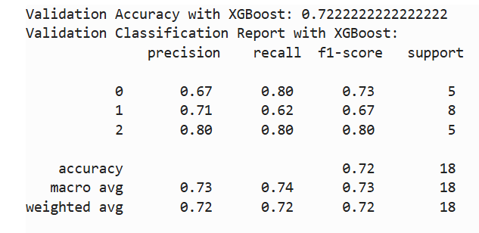
Model Performance Summary
The XGBoost model was evaluated using both validation and test datasets to assess its effectiveness in predicting project priorities. Here are the results:
Validation Performance
Accuracy: 0.72
Precision: Macro average of 0.73 and weighted average of 0.72
Recall: Macro average of 0.74 and weighted average of 0.72
F1-Score: Macro average of 0.73 and weighted average of 0.72
Class-wise Metrics
Class 0: Precision = 0.67, Recall = 0.80, F1-Score = 0.73
Class 1: Precision = 0.71, Recall = 0.62, F1-Score = 0.67
Class 2: Precision = 0.80, Recall = 0.80, F1-Score = 0.80
The validation results demonstrate an overall balanced performance across classes, with the model achieving its highest F1-Score (0.80) for Class 2.

Slide 25
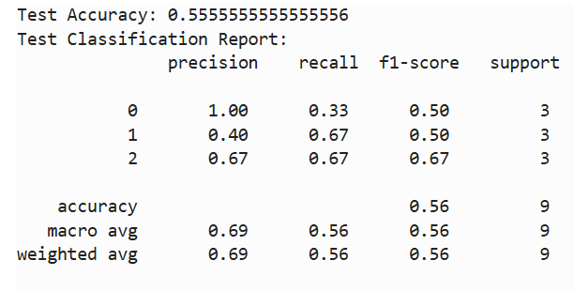
Model Performance Summary
Test Performance
Accuracy: 0.56
Precision: Macro average of 0.69 and weighted average of 0.69
Recall: Macro average of 0.56 and weighted average of 0.56
F1-Score: Macro average of 0.56 and weighted average of 0.56
Class-wise Metrics
Class 0: Precision = 1.00, Recall = 0.33, F1-Score = 0.50
Class 1: Precision = 0.40, Recall = 0.67, F1-Score = 0.50
Class 2: Precision = 0.67, Recall = 0.67, F1-Score = 0.67
The test results indicate lower performance, with an accuracy of 0.56. Class 0 shows perfect precision but low recall, while Class 2 maintains the highest F1-Score (0.67) among the classes, suggesting the model struggles with generalization on this test set.
Overall, while the model performed reasonably well on the validation data, the test results reveal room for improvement in its ability to generalize, particularly for Class 0.

Slide 26
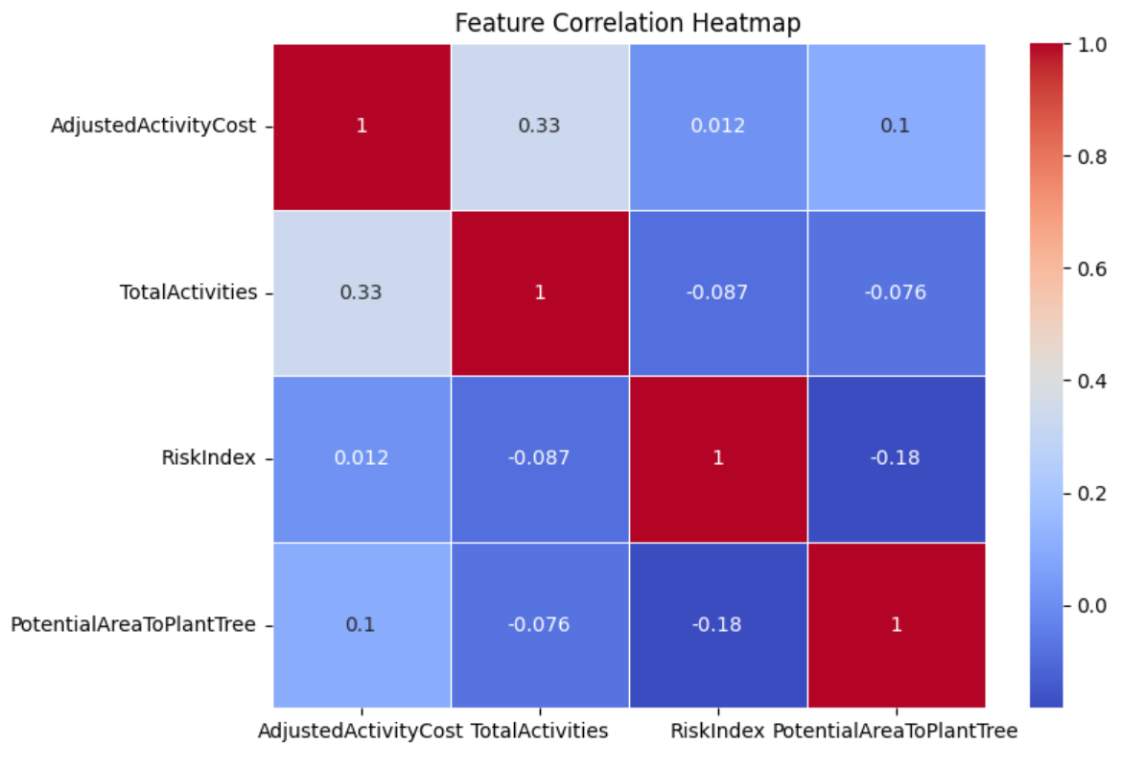
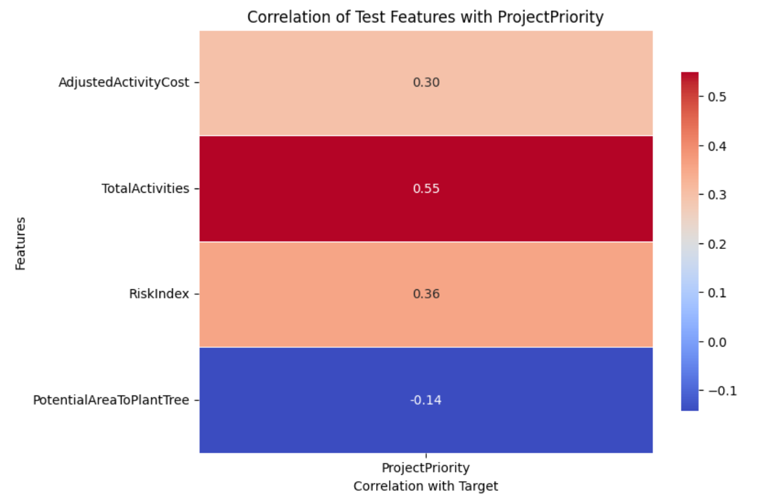
Visualizations:
Feature Correlation Heatmap: A heatmap showing correlations between features helped us identify any multicollinearity issues and understand relationships among features, informing feature selection and engineering.
Target Correlation Heatmap: A second heatmap displayed correlations between each feature and the target variable (project priority), highlighting which features were most predictive.

Slide 27
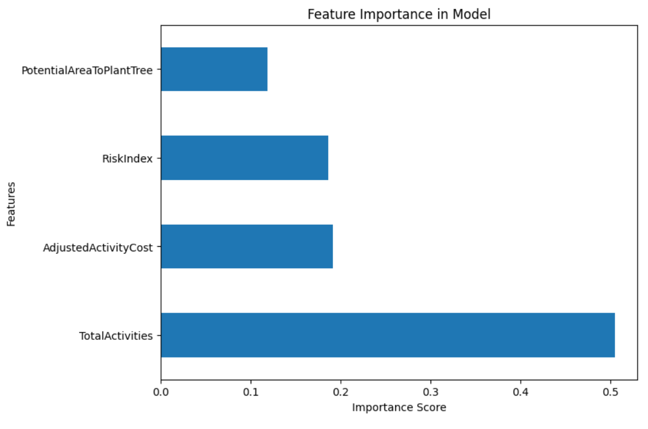
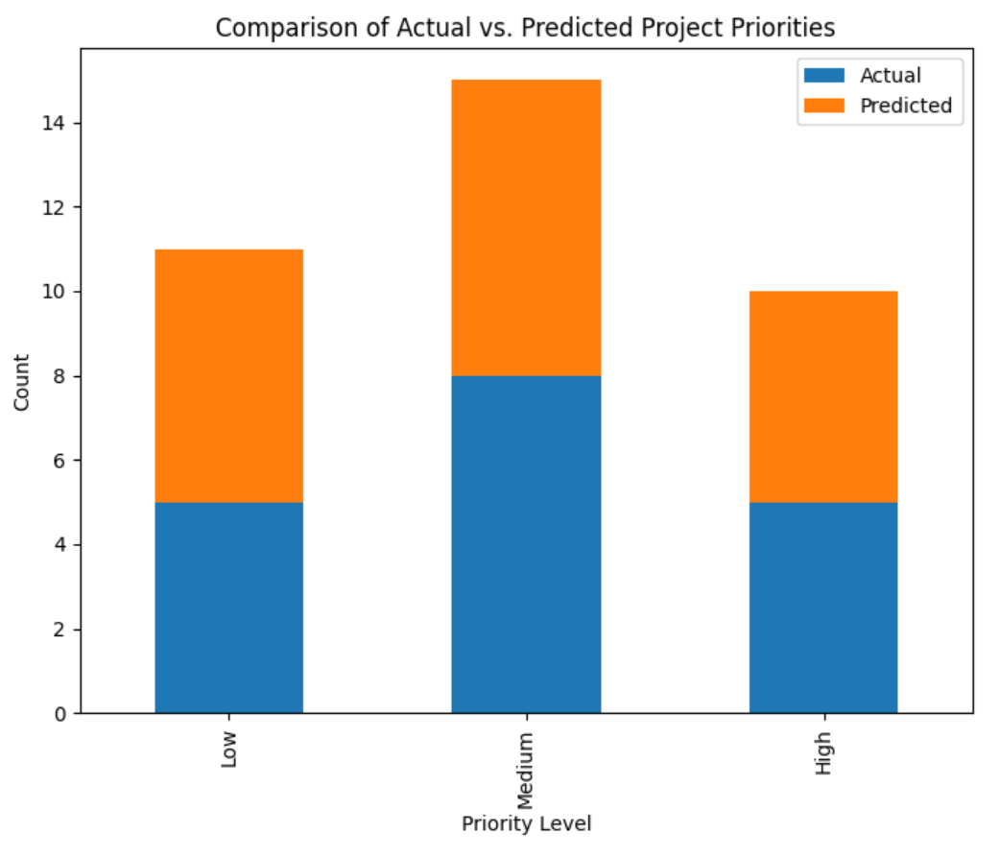
Visualizations:
Feature Importance Bar Charts: Produced from the XGBoost model, these charts showcased the impact of each feature on predicting project priority.
Actual vs. Predicted Comparisons: Plots comparing actual outcomes with predictions helped evaluate model precision.

Slide 28
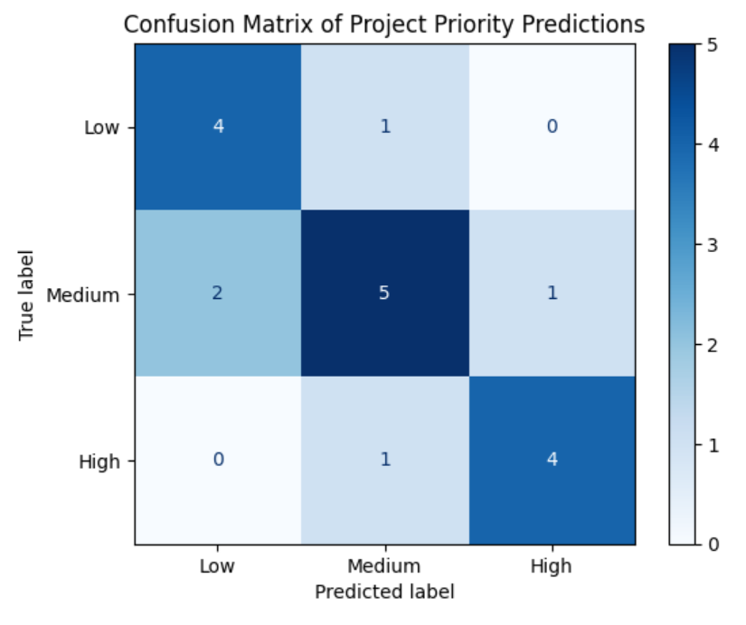
Visualizations:
Confusion Matrix: Illustrated true positives, false positives, true negatives, and false negatives, giving a detailed view of classification performance.

Slide 29
Future

Slide 30
Future Improvements:
The model developed here effectively uses existing data to determine the optimal path forward. In the future, this approach could be expanded to guide ABC in exploring additional funding opportunities. By integrating data on grant trends over time, we could identify potential opportunities to approach specific donors for further support, helping ABC strategically plan for sustainable conservation funding.

Slide 31
Thank you

